Slide 1
Python pass Statement
DVT101 – Lecture 11
- By Dataverse Tutorials

Slide 2
Why Do We Need the pass Statement in Python?
Python requires an indented block after certain statements
Sometimes logic is not ready yet
pass acts as a placeholder
Keeps code syntactically valid
Helps in step-by-step development

Slide 3
What is pass?
pass is a null statement
It performs no operation
Used as a placeholder
Program execution continues normally
Prevents syntax errors

Slide 4
How pass Works Internally
Python parser expects a statement
pass satisfies parser requirement
No bytecode logic added
Execution pointer moves ahead
Used during incremental development

Slide 5
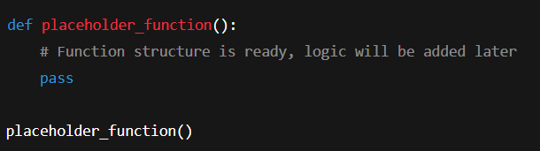
Using pass Inside Functions
Allows empty function definition
Useful during design phase
Prevents syntax error
Logic can be added later
Common in large projects

Slide 6
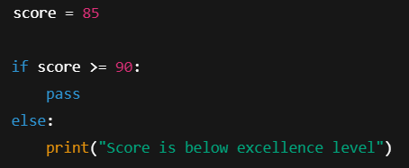
Using pass in if-else Blocks
Used when no action is needed
Keeps condition structure valid
Helps future logic insertion
Avoids unnecessary prints

Slide 7
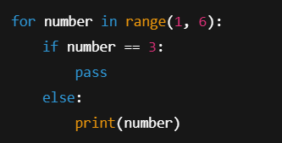
Using pass Inside Loops
Loop structure remains intact
No action for specific condition
Different from continue
Useful in filtering logic

Slide 8
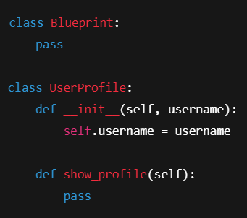
Using pass in Classes
Allows empty class creation
Supports object-oriented design
Used in framework development
Helps scaffold architecture

Slide 9
Where is pass Used in Industry?
API skeleton design
Machine Learning pipelines
Feature planning
Framework development
Agile development workflow

Slide 10
Where is pass Used in Industry?
API skeleton design
Machine Learning pipelines
Feature planning
Framework development
Agile development workflow

Slide 11
Key Takeaways – Python pass
pass does nothing but is powerful
Prevents syntax errors
Used as placeholder
Helpful in structured coding
Essential for clean design

Slide 12


